Slide 1

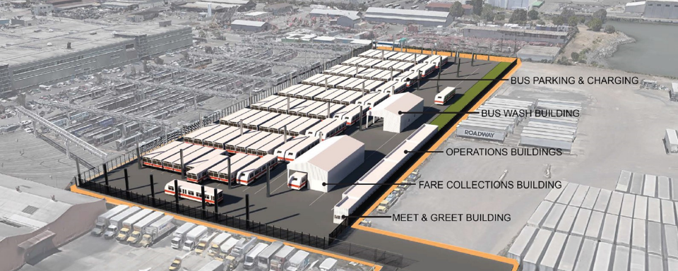
Muni Metro East Bus Yard & 1399 Marin Facilities Presentation
BUILDINGPROGRESS
Muni Metro East Bus Yard
& 1399 Marin Street Facilities
Dogpatch Neighborhood Association Update
November 8, 2022

Slide 2
Building Progress Program overview
BUILDING PROGRESS
Program Overview
The SFMTA launched the
Building Progress Program in Fall 2017.
Modernize aging SFMTA facilities in order to meet the needs of everyone who travels in San Francisco
Improve the transportation system’s resiliency to seismic events, climate change, technology changes
Make the SFMTA a better neighbor in the parts of the city that currently host our facilities
State of Good Repair
Resiliency
Community

Slide 3
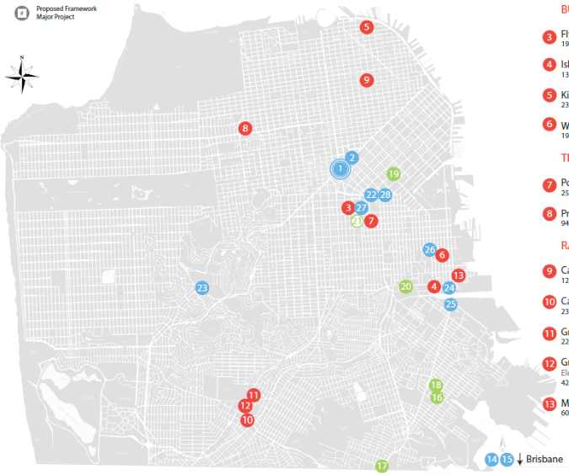
Facilities Condition Assessment/State of Good Repair
BUILDING PROGRESS
2016 Facilities Condition Assessment (FCA Program/FIX)
20+
Facilities
Red: Bus Facilities/Rail Facilities
Green: Streets Facilities
Blue: Support Facilities
60+
Acres
$60 m
Corrective Maintenance
$200 m
Preventative Maintenance
2.5 m
Sq. Ft. Building
3

Slide 4
Modernization Program
BUILDING PROGRESS
Modernization Program (DELIVER)
The Building Progress Modernization Program
is a $2 billion+ capital program designed to meet the current and future facility needs of the SFMTA.
Modernization of Muni operational workspaces and maintenance equipment for growth and resiliency.
Transformation of Muni Yards to support both the trolley fleets and expansion to Battery Electric Busses.
Modernization
Electrification
Joint
Development
Innovative Project delivery to finance Muni capital, maintenance and operations into the future.

Slide 5
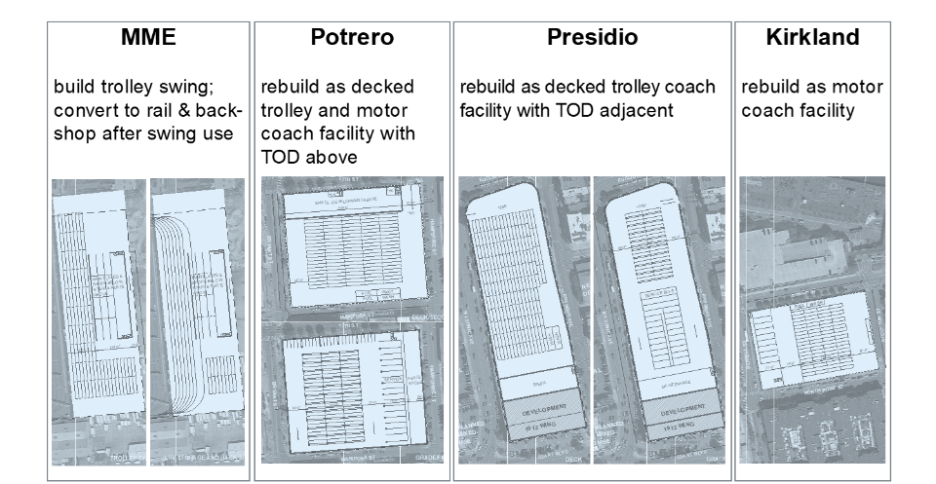

Modernization Program cont’d
BUILDING PROGRESS
Modernization Program
MME
Construct temporary bus yard to serve as swing facility during modernization projects
Potrero
Rebuild as multi-level trolley and motor coach facility with private development above
Presidio
Rebuild as multi-level trolley and motor coach facility with private development adjacent
Kirkland
Modernize as a new Zero Emission Bus Facility
Project at 100% design
Predevelopment
Agreement Phase
Planning/Site Programming
Planning

Slide 6
Potrero Yard Modernization Project
BUILDINGPROGRESS
Potrero Yard Modernization Project
Potrero Yard Modernization Project
Nov 1, 2022: SFMTA Board of Directors
approves Predevelopment Agreement
The selected Preferred Proposer development team
Lead Developer: The Potrero Neighborhood Collective, LLC
Plenary Americas US Holdings Inc. is the sole equity member
Affordable Housing Developer: Mission Economic Development Agency, Young Community Developers, Inc., and Tabernacle Community Development Corp.
Housing Developer: Presidio Development Partners, LLC and Tabernacle Community Development Corp.
Design Consultant: IBI Group, Y.A. studio
Construction Management Consultant: Plant Construction Company, L.P., The Allen Group LLC
Infrastructure Facility Management Consultant: WT Partnership

Slide 7
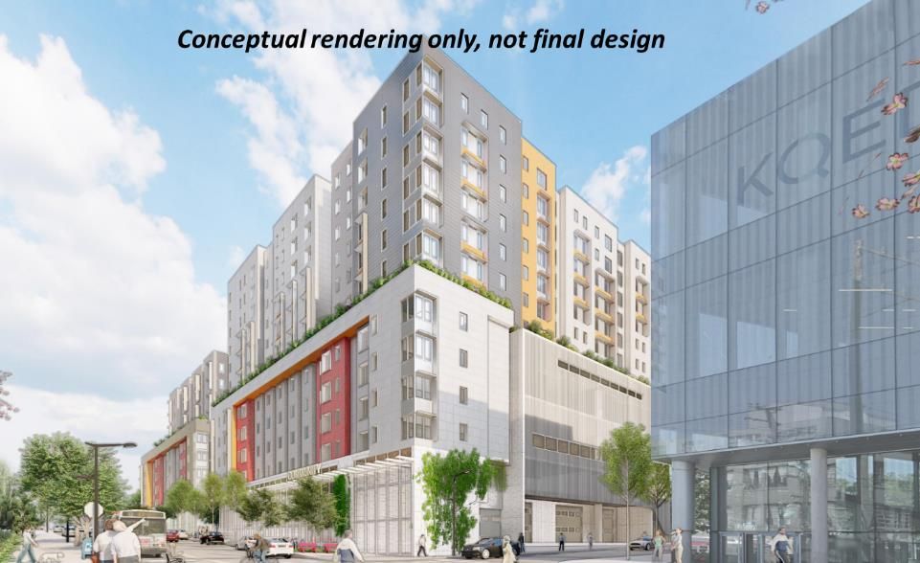
Potrero Yard Modernization Project
BUILDINGPROGRESS
Potrero Yard Modernization Project

Slide 8
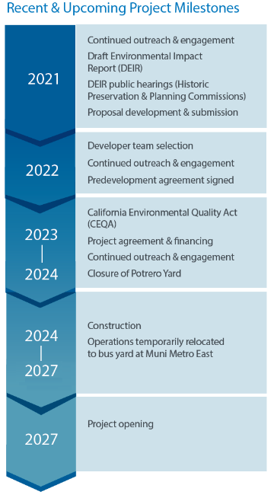
Potrero Yard Modernization Project – timeline
BUILDINGPROGRESS
Potrero Yard Modernization Project
Proposal Features
Three-level modernized bus yard
Up to 150’ high
575 residential units
100% affordable
Approx 10,000 sq ft for community & commercial uses
Transportation
TDM program to encourage sustainable modes of transportation
Resident and employee parking not included in current program

Slide 9
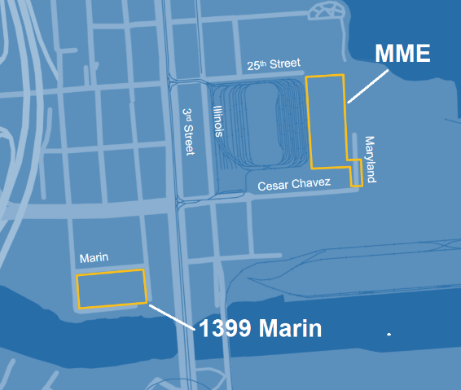
Temporary Facilities
BUILDINGPROGRESS
Temporary Facilities
As a bus yard is taken offline for construction:
Yard operations will be relocated to a temporary bus yard at Muni Metro East (MME)
Heavy maintenance functions will be relocated to 1399 Marin Street

Slide 10
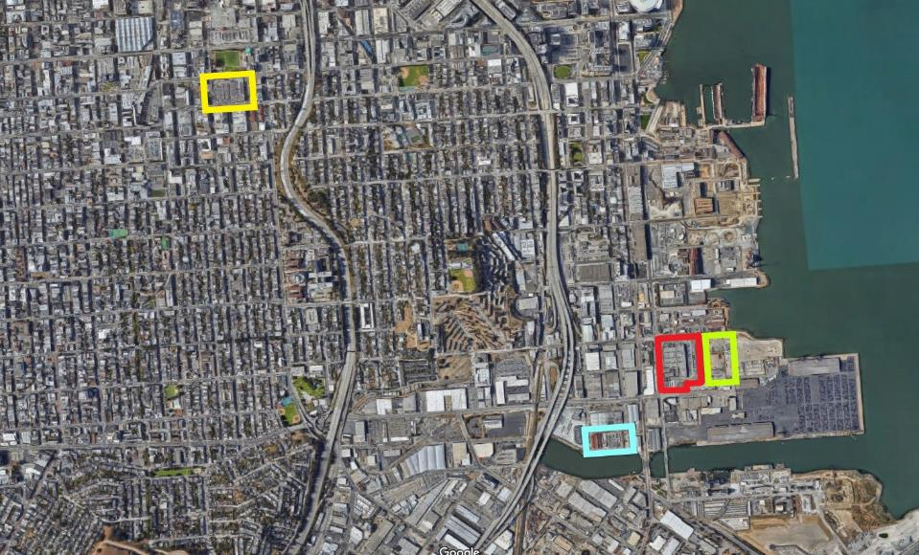
Project Locations
BUILDINGPROGRESS
Project Locations
POTRERO YARD
MUNI METRO EAST (EXISTING)
MUNI METRO EAST (EXPANSION)
1399 MARIN
BUILDINGPROGRESS

Slide 11
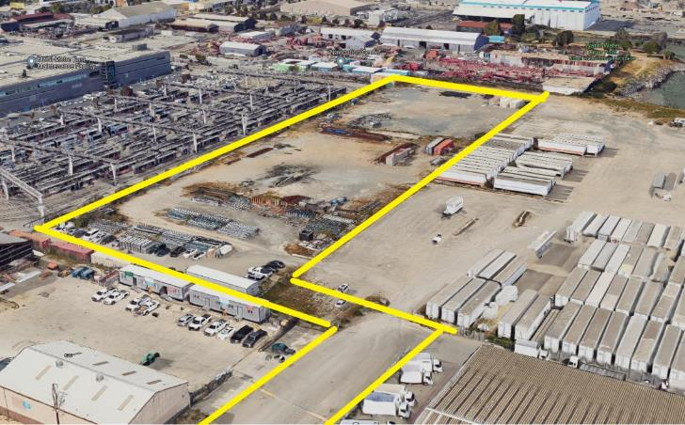
Temporary Bus Yard at Muni Metro East (MME) -- site
BUILDINGPROGRESS
Temporary Bus Yard at Muni Metro East (MME)
Site: Four-acre parcel adjacent to the current MME rail facility.

Slide 12
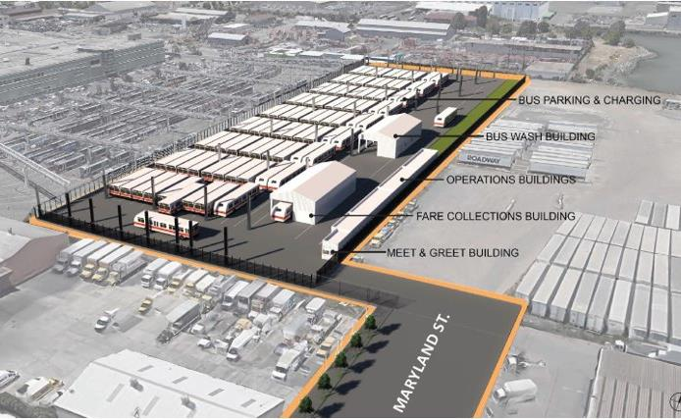
Temporary Bus Yard at Muni Metro East (MME) -- goal
BUILDINGPROGRESS
Temporary Bus Yard at Muni Metro East (MME)
Goal: Expand trolley bus parking capacity within the SFMTA transit system to provide flexibility for capital projects.​

Slide 13
Temporary Bus Yard at Muni Metro East (MME) – scope
BUILDINGPROGRESS
Temporary Bus Yard at Muni Metro East (MME)
Project Scope
Bus parking with overhead trolley charging
Bus wash building
Fare collections building
Operations and administrative support functions​
Access from Maryland Street
Re-striping of Cesar Chavez

Slide 14
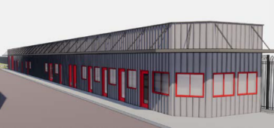

Temporary Bus Yard at Muni Metro East (MME)
BUILDINGPROGRESS
Temporary Bus Yard at Muni Metro East (MME)
Operations
Offices, break rooms, restrooms, lockers, and security
Fare Collection
Drive-thru collections building
Bus Wash
Served by below-grade rainwater harvesting cistern, Muni logo branding
HIGHLY VISIBLE MUNI LOGOS
IDENTIFY FACILITY

Slide 15
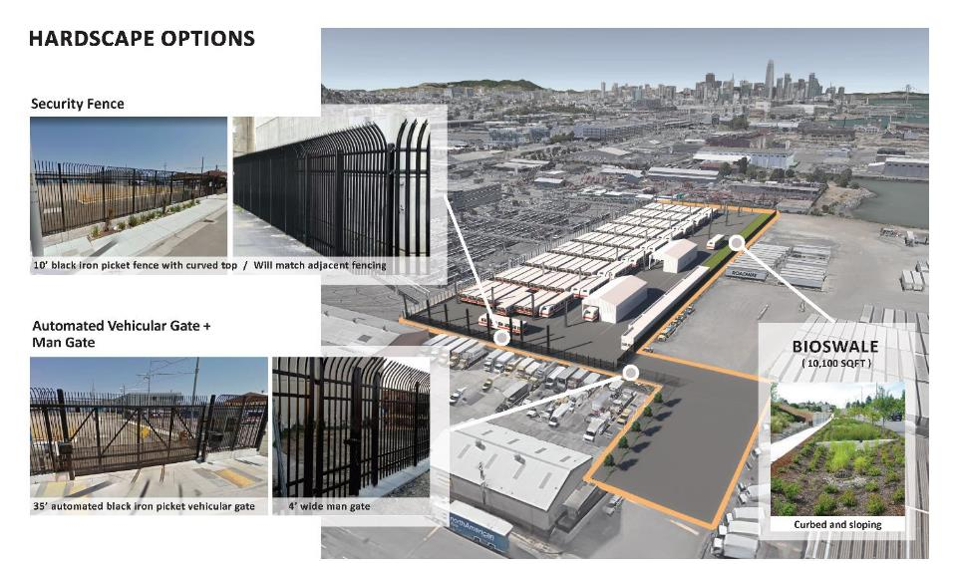
Temporary Bus Yard at Muni Metro East (MME) -- landscaping
BUILDINGPROGRESS
Temporary Bus Yard at Muni Metro East (MME)

Slide 16
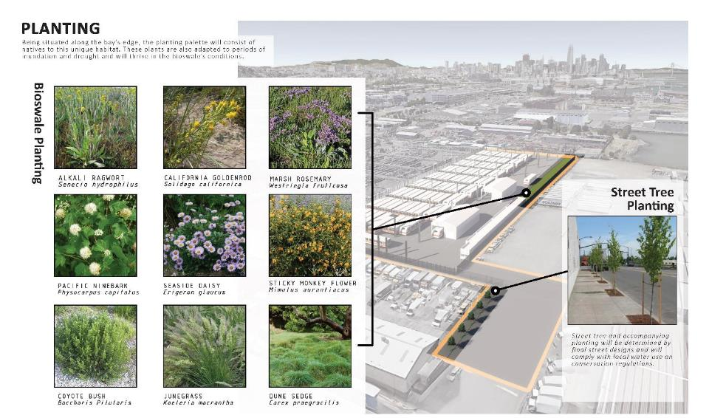
Temporary Bus Yard at Muni Metro East (MME) -- landscaping
BUILDINGPROGRESS
Temporary Bus Yard at Muni Metro East (MME)
Muni Metro East (MME)

Slide 17
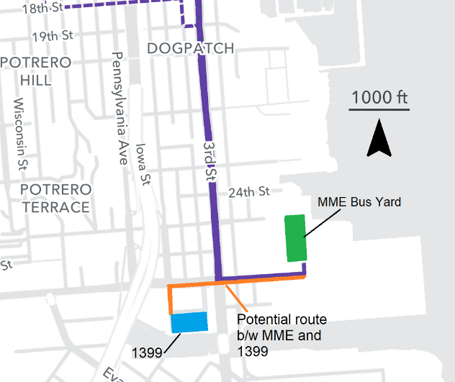
Temporary Bus Yard at Muni Metro East (MME) – access for coaches and to/from 1399
BUILDINGPROGRESS
Pull-Outs, Pull-Ins, Route Between Facilities
Primary access to MME Bus yard via 3rd Street
Pull Outs: 4–7am
Pull Ins: 6pm–2am
Probable route between facilities: Cesar Chavez and Indiana streets
Indiana St
Cesar Chavez St
BUILDINGPROGRESS

Slide 18
Temporary Bus Yard at Muni Metro East (MME) -- schedule
BUILDINGPROGRESS
Temporary Bus Yard at Muni Metro East (MME)
2021
CEQA review complete, Civic Design Review Phase 3 approval
2022
100% Design completed, Notice of intent to award PDA for Potrero Yard Project (10/17/22), Prepping/clearing 4-acre site
2023
Grading, Utilities (25th St), Construction starts (MME contractor will be procured by the Potrero Lead Developer)
BUILDINGPROGRESS

Slide 19
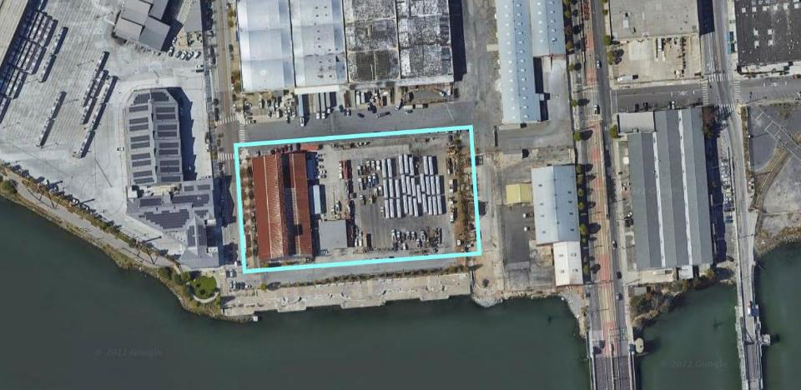
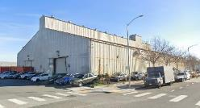
Temporary Maintenance Facility at 1399 Marin
BUILDINGPROGRESS
Temporary Maintenance Facility at 1399 Marin Street
Site: 3.2-acre site located off Cesar Chavez and west of Third Street. Leased by the SFMTA from the Port. It will host both heavy maintenance for electric trolley buses and serve as the SFMTA’s bus acceptance facility.
ISLAIS CREEK FACILITY
Tennessee St
Indiana St
Marin St
Marin St
1399 MARIN FACILITY
Illinois Street
3rd Street
Tulare St
View from Indiana and Marin streets

Slide 20
BUILDINGPROGRESS
Temporary Trolley Bus Facility: 1399 Marin — Overview
Goal: Maintain electric trolley buses -- which are stored at Muni Metro East -- during capital projects.​
Rendering of 25’ high canopy over maintenance bays at 1399 Marin Street

Slide 21
Temporary Maintenance Facility at 1399 Marin
BUILDINGPROGRESS
Temporary Maintenance Facility at 1399 Marin Street
Capacity: 39 buses in yard, +2 exterior canopy bays, +6 interior bays
Features: Refurbished warehouse, upgraded drainage system and perimeter planters to control water flow, new security fencing and gates.
1399 Marin Street maintenance facility diagram

Slide 22
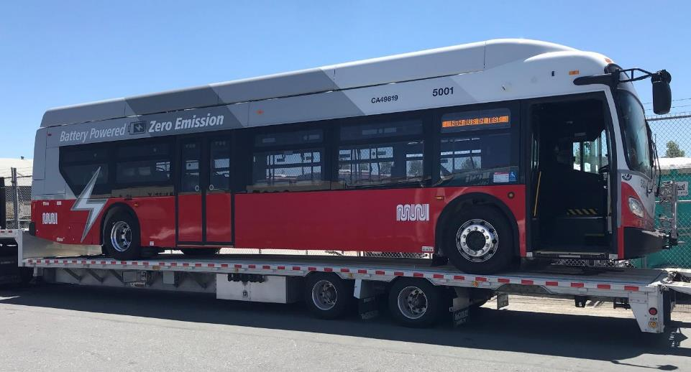
Battery Electric Buses
BUILDINGPROGRESS
Bus Yard at Muni Metro East
E-Bus Delivery to 1399 Marin
May 20, 2021

Slide 23
What’s in Proposition L?
Prop L
Funds ~$2.6 billion for transportation projects over 30 years
Extends a half-cent sales tax. Does not increase taxes
Requires 2/3 majority to pass. If it does not pass, the tax ends in 2034
Notes:
Measure L is on the ballot in San Francisco November 8
If passed, it would extend a half-cent sales tax for 30 years to fund transportation projects for Muni and BART, walking and bicycling improvements, signals, traffic calming and paratransit
It does not increase taxes and it requires 2/3 majority to pass
If it does not pass, the existing tax continues until 2034

Slide 24
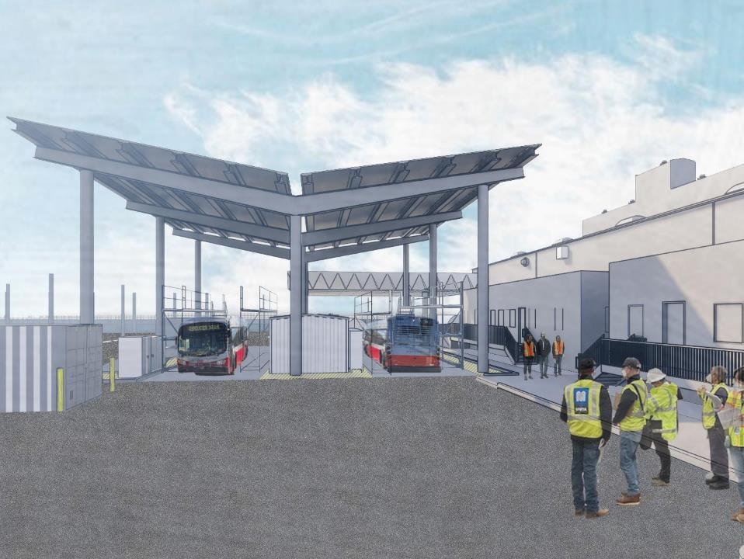

Thank you
Thank You.
Bonnie Jean von Krogh
Public Relations Officer, Building Progress Program
BonnieJean.vonKrogh@SFMTA.com
John Angelico
Public Information Officer, Communications
John.Angelico@SFMTA.com

Slide 25
Thank you
Thank You.
Bonnie Jean von Krogh
Public Relations Officer, Building Progress Program
BonnieJean.vonKrogh@SFMTA.com
John Angelico
Public Information Officer, Communications
John.Angelico@SFMTA.com

Slide 26
Building Progress Program overview cont’d
BUILDING PROGRESS
Program Overview
Core programs and initiatives
currently include the following.
Modernization Program
Muni Metro East Expansion
Potrero Yard Modernization
Presidio Yard Modernization
Kirkland Yard Modernization
Electrification Program
Woods Chargers Pilot Project
Battery Electric Bus (BEB) Facility Master Plan
Cable Car Barn Program
Cable Car Barn Improvements
Cable Car Barn Master Plan
Joint-Development
Program
4th and Folsom
Parking Garages
Surface Parking Lots
Yard Modernization
Capital
Program
Burke Rehabilitation
Presidio Lifts & Scott Lifts
1200 15th Street PCO HQ
Station Escalators
Operator Restrooms
Facility Condition Assessment (FCA) Program
Implementation of $200+ million in deferred
maintenance and repairs

Slide 27
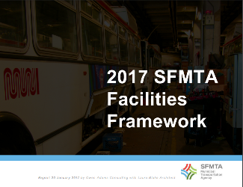
BUILDING PROGRESS
2017 Facilities Framework (PLAN)
The Framework was a dynamic plan for the upgrade, management, acquisition and development of the SFMTA’s buildings and grounds.
It included a flexible improvement program to deal with facility conditions, safety, workforce satisfaction and a changing and growing transit fleet and evolving mobility needs.
Most important, the framework included costs and realistic, constrained financial scenarios.
Facility Condition Assessment
Fleet Requirement Analysis
Organizational Assessment
Alternatives Analysis
Corrective Maintenance Program
Preventative Maintenance Program
15-Year Capital Program
Link: 2017 SFMTA Facilities Framework

Slide 28
BUILDING PROGRESS
Innovation
The Building Progress Program uses both best practice and lessons learned from prior SFMTA capital initiatives to optimize project delivery.
Master Scheduling & Sequence
Master POETS Outreach Plan
Master Multi-Departmental MOU
Master Cost Estimator
Contract Management/BAFO
Parallel Task/Initiative Management
Project Risk Management & Registers
Pay-Go Financial Model
Innovative Project Delivery (P3, etc.)
Implementing Project Mgt. Oversight
Secured as needed technical support before it was needed:
WSP (Electrification)
Hatch (Urban Design)
SWCA (Environmental Review)
ARUP (Joint-Development Advisor)
Held 3 All-Day POETS workshops for long range outreach planning
Key Messages
Commitments to the Community
Layers of Engagement
Implementing various delivery models
Design Build/Finance/Maintain (DBFM) @ Potrero
Progressive Design-Build @ 1399 Marin
Early Works Construction @ Muni Metro East
Sequenced Multi-Phase Construction @ Burke

Slide 29

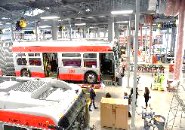


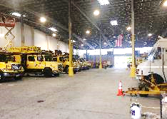


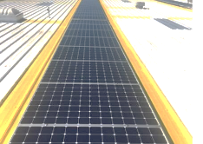
BUILDING PROGRESS
Performance
Islais Creek
Completed
PCO
HQ
$8.2 million
Repairs
Restroom Refresh Campaign
1200 15th Street: Transferred property from GSA; began design
HVAC Campaign
Breakroom Campaign
Burke
Completed
Rebuilt at:
Montgomery
Powell
Hallidie Plaza
Civic Center
Van Ness
Church
Castro
MME
Muni Metro East Expansion: Environmentally Cleared; 100% designed
17
Escalators
Potrero
Potrero Modernization: Draft EIR Complete; Special Legislation; P3 RFQ/RFP Released
Bancroft
Completed
14
Operator Restrooms
New operator convenience facilities at various terminal locations

